Slide 1


RAJALAKSHMI ENGINEERING COLLEGE
Department of Information Technology
STRESS DETECTION AND REDUCTION FOR
IT PROFESSTIONALS
SUPERVISOR
DR S KAYALVIZHI , Ph.D.
Assistant Professor(SG),
Department of IT, REC
TEAM MEMBERS
SREEKRISHNA P A(181001093)
SRIMANJEY R (181001095)
SUGUMARAN B(181001102)

Slide 2
OBJECTIVE
The main objective of the Stress Detection and Reduction System for IT Professional by Image Processing and Machine Learning is to detect the stress level of the IT professionals and provide them remedies to reduce their stress and become more efficient at work.

Slide 3
ABSTRACT
This study aims to develop a system to detect the stress level of IT professionals and provide them with remedies to reduce stress.
The system takes video as input either at real-time or through a pre-recorded video.
The system then analyses this video and identifies if an employee is stressed or not through the mini-Xception model of the CNN algorithm.

Slide 4
ABSTRACT
When an employee is classified as stressed, the system starts to calculate their stress level.
The stress level is calculated through the displacement of eyebrow from its mean position and through a survey form.
Based on the calculated stress level, the system provides remedies to the stressed employees.

Slide 5
INTRODUCTION
The IT industry is developing at a rapid pace.
Studies shows that the IT industry is developing at a rate of 8% every year.
For achieving this growth, the industry introduces new technologies and demands its employees to cope up with its pace which in turn develops stress in employees.
The World Health Organization (WHO) says “Stress may be a psychological state drawback moving the lifetime of one in four voters”.

Slide 6
INTRODUCTION
As the IT industry is stress prone, it is not possible to completely avoid stress but it is possible to reduce stress in such circumstances.
This project aims to monitor the employee at real-time to check whether they are stressed or not.
In case an employee is stressed, the system provides the employee’s with remedies to reduce their stress.
This in turn reduces the stress level of the employee making them more focused and motivated.

Slide 7
EXISTING SYSTEM
In the existing systems, to recognize depression level, Brindahini Vimaleswaran [1] proposed a solution for detecting the depression level in youth and providing them therapy.
They used feed-forward Neural Network (FFNN) for image processing and detecting depression level.
In the driver stress monitoring system [4],the system is used to detect the driver stress dynamically and alerts the driver and analyse the data by using the Xgboost algorithm.

Slide 8
LIMITATIONS OF EXISTING SYSTEM
The depression level approach by Vimaleshwaran[1] focuses only on youth facing depression.
It notes only limited emotions such as disgust , happy and contempt.
The classification of the images to predict depression resulted in only 62% accuracy.
Limitations of driver stress monitoring system is that only recognition has been done so the Xgboost algorithm is dependent.

Slide 9
PROPOSED SYSTEM
Stress Detection system is existing in various sectors. Concepts like implementing the stress detection have been developed before however this project mainly focus to enhance the IT sector to help both the organization and its employees.
The project aims to promote a healthy work environment and an efficient work culture by providing remedies to reduce the stress level of the employees.

Slide 10
PROPOSED SYSTEM
The system performs stress detection in two ways:
The system recognizes the face of the employee through real-time video.
The system performs stress detection by recognizing the face of the employee through a pre-recorded video.
The system uses FER2013 dataset. It has approximately 30000 images.
The system then monitors the emotion of the employee and classifies whether they are stressed or not.

Slide 11
PROPOSED SYSTEM
When the system classifies an employee to be stressed, it starts to calculate the stress level of that employee.
The stress level is calculated by the displacement of eyebrow from its mean position and through a survey form.
Based on the calculated stress level the system provides remedies to the employee.

Slide 12
PROPOSED SYSTEM
Remedies are provided to the employees based on their stress level helping them to reduce their stress and become efficient.
Herewith we are using mini-Xception which is efficient to recognize the facial emotion of an individual.
The system identifies seven types of emotions such as: “happy”, “surprise”, “sad”, “angry”, “neutral”, scared”, “disgust”.

Slide 13
PROPOSED SYSTEM
The remedies that the system provides include:
Suggesting the employee to take a break
Playing them a short meditation video to make them understand the benefits of meditation and start practicing them.
Providing access to YouTube.
Providing access to a gaming platform.
Proving them with Food Coupons
Granting a paid leave.

Slide 14
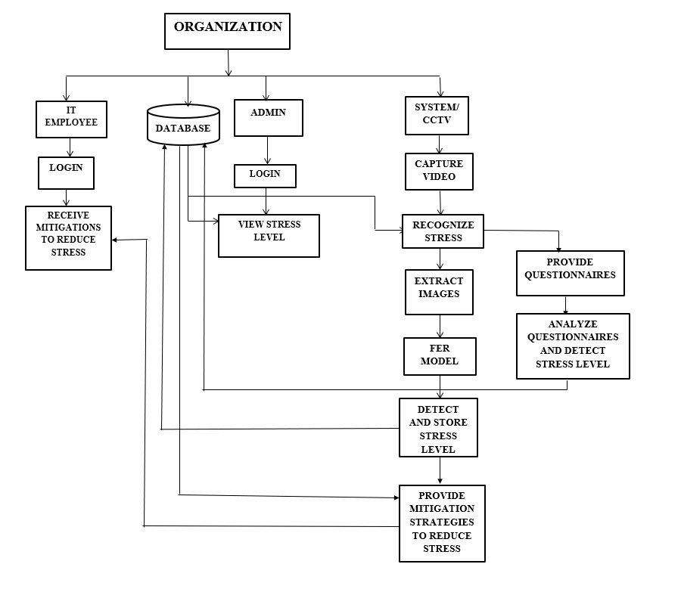
ARCHITECTURAL DESIGN FOR PROPOSED SYSTEM
FER MODEL – FACIAL EMOTION RECOGNITION MODEL

Slide 15
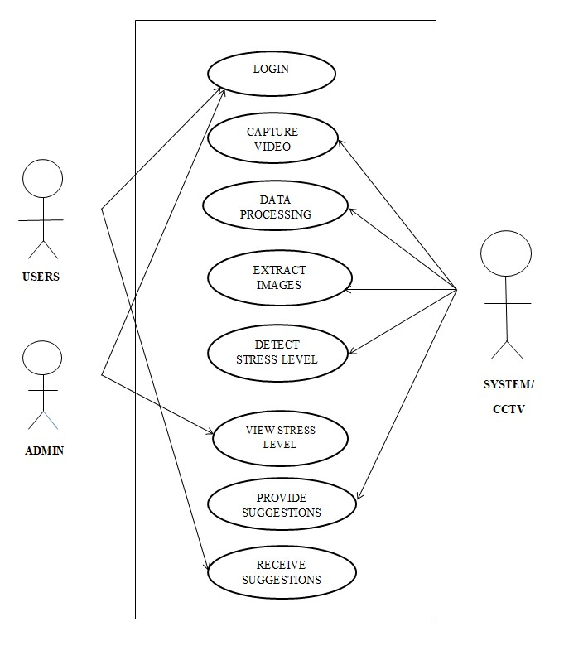
ER/ USE CASE DIAGRAM
Diagram representing the actors in the system and their interactions with the system

Slide 16
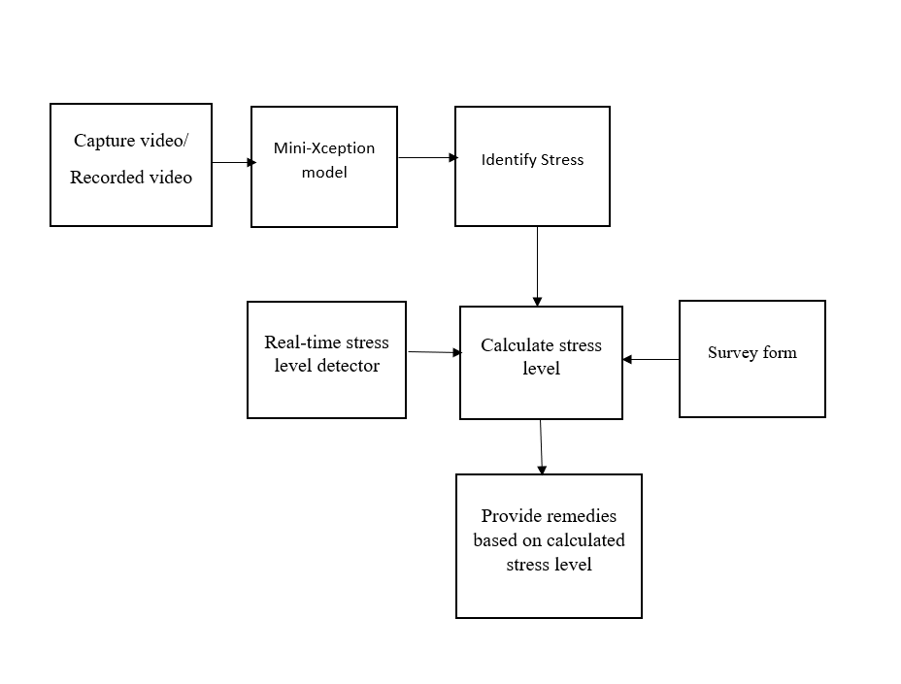
BLOCK DIAGRAM
Diagram representing the overall system workflow

Slide 17
ADVANTAGES OF
PROPOSED SYSTEM
By using CNN with mini-Xception, it helps in reducing the amount of parameters in the remaining convolutional layers making the system fast.
Also the system provides real-time remedies to its employees promoting an healthy work culture.

Slide 18
HARDWARE USED:
RAM: 4GB(minimum)
Processor: 64-bit,1.80GHz minimum
Input: Any kind of video file or webcam input with human face.
SOFTWARE USED:
Operating system: Windows
Technology: Anaconda, flask, sqlite, web designing languages(HTML, css).
IDE: Jupyter notebook, Python
LIST OF HARDWARE AND SOFTWARE USED

Slide 19
MODULES DESCRIPTION
Login Module: This model allows the users and Admin to login.
Stress Detection Module: This module is used to detect whether a user is stressed or not through video monitoring.
Stress Evaluation Module: This module requires the user to provide feedback in case they are stressed and it detects the stress level based on the response and through the real-time video analysis.
Stress Mitigation Module: This module involves the system to provide remedies to stressed employee. The remedy provided depends on the stress level of the employee.

Slide 20
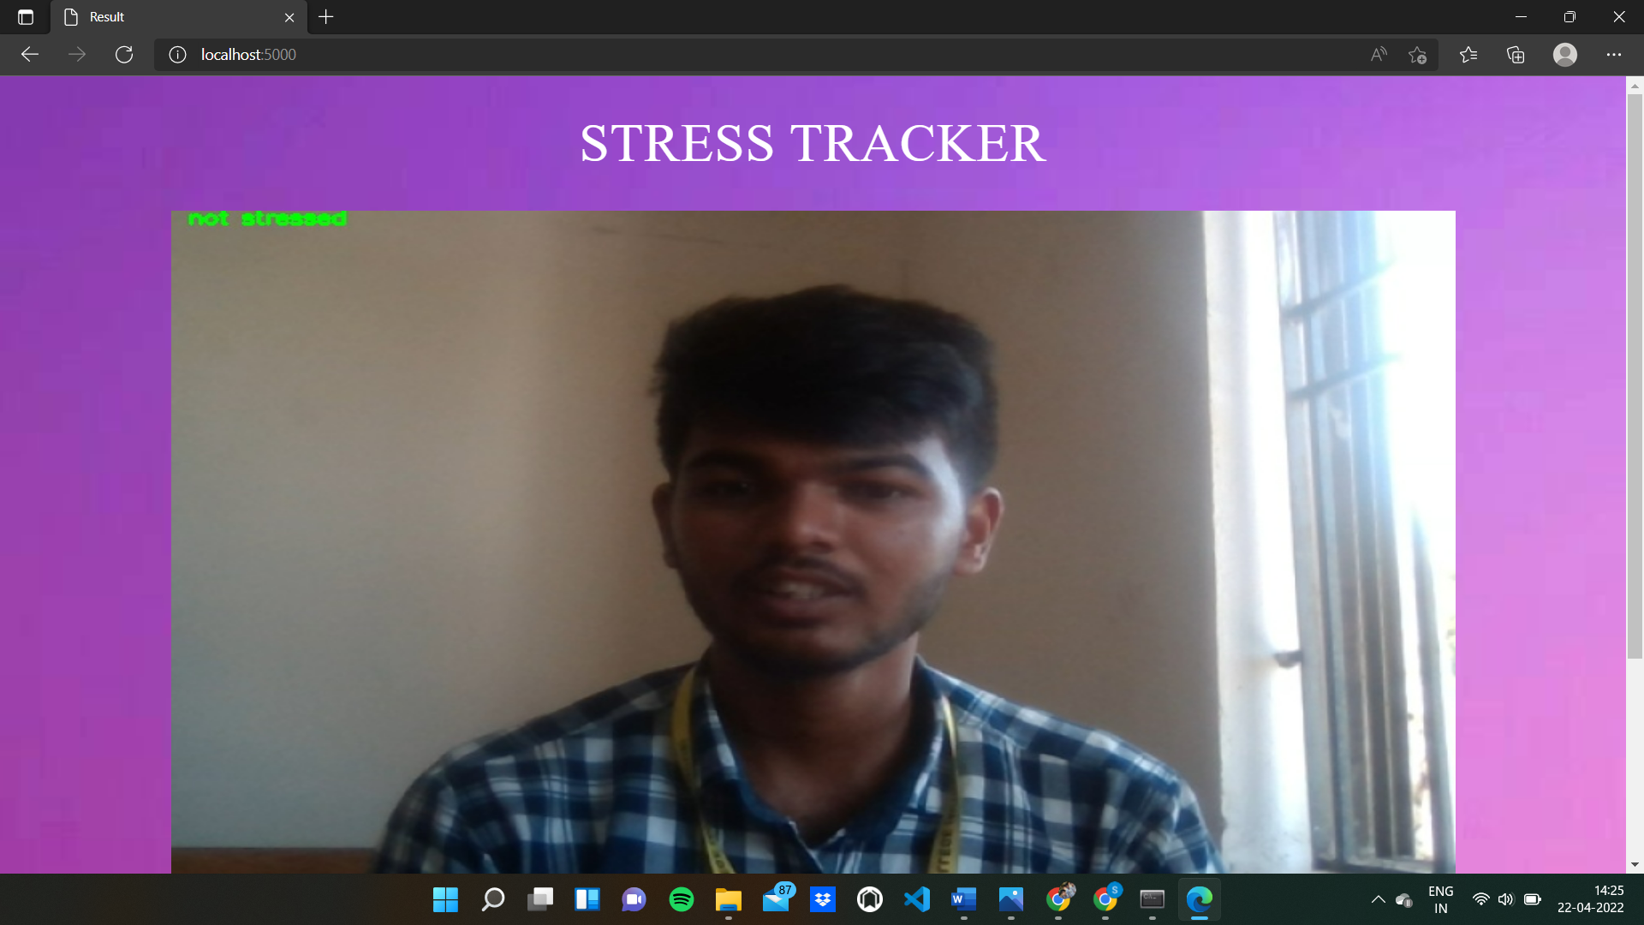
SNAPSHOTS
STRESS DETECTION PORTAL

Slide 21
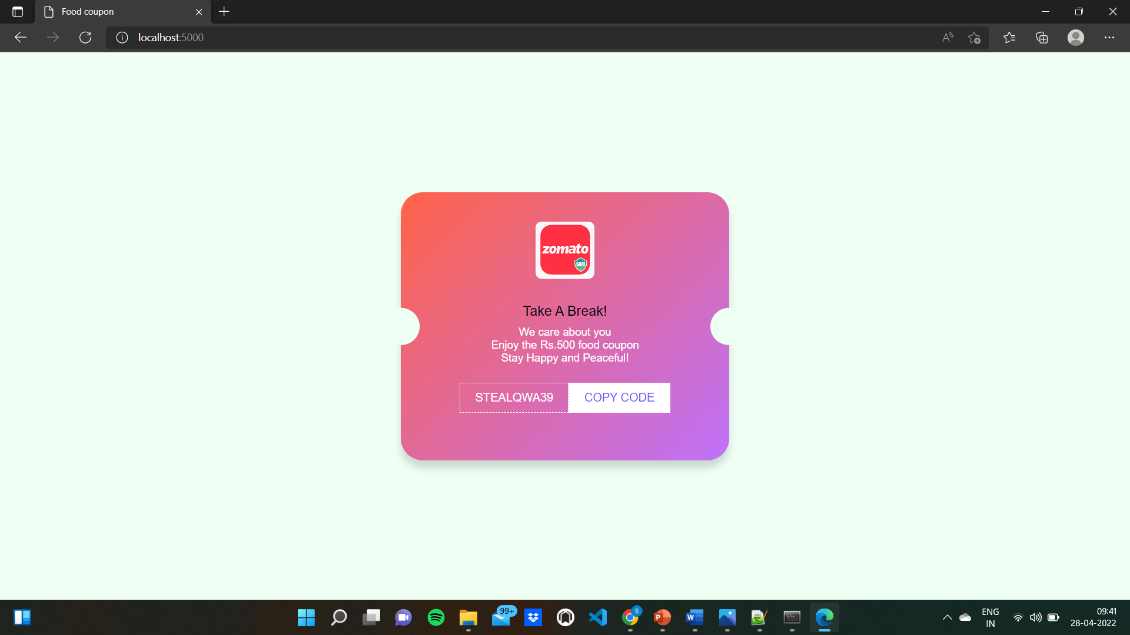
SNAPSHOTS
FOOD COUPON AS REMEDY

Slide 22
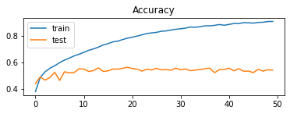
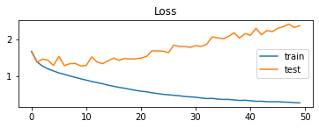
TESTING AND ANALYSIS
The graph represent the training and test accuracy of the proposed model in each epoch
The graph represent the cross-entropy loss for both the training and testing data set.

Slide 23
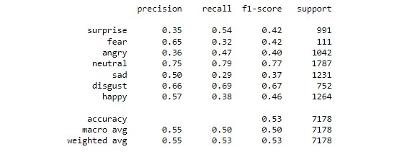
TESTING AND ANALYSIS
The diagram represents the performance metrics of the system.

Slide 24
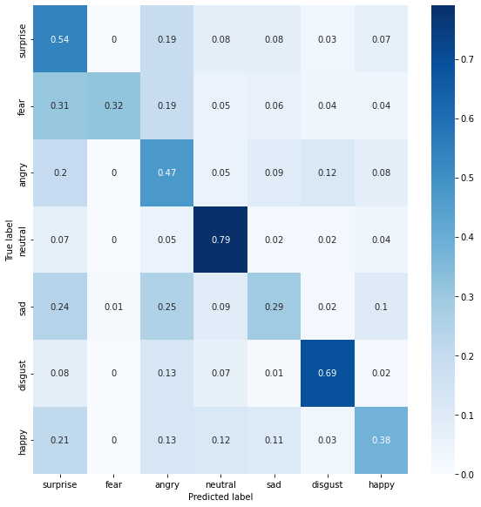
TESTING AND ANALYSIS
The diagram represents the confusion matrix of the model

Slide 25
FUTURE ENHANCEMENTS
The application of this mini-Xception algorithm is extensive. Now-a-days recent advancement in technologies has pushed the limits further for man to move away from older equipment which posed inconvenience in using.
Though there is significant progress in the identification of facial emotions in the past decade, there are some outstanding issues and new avenues exist for future development.

Slide 26
FUTURE ENHANCEMENTS
MOVEMENT ANALYSIS: The extraction of facial emotion depends on the ability to detect facial feature points, the semantic location of which has been predefined. It would therefore be useful in the future to design an end-to-end model capable of both learning the movement of face during facial-emotion recognition and detecting facial feature points. In this way, one could arrive at a more accurate system.

Slide 27
CONCLUSION
Stress detection system has a wide range of applicability in various industries such as: IT sector, Banking sector, Lie detection, criminal justice, etc which enables to detect stress in our day-to-day activities.
But detecting stress in real-time is of no use if not acted upon to reduce stress.
Hence the proposed system is designed to detect stress by monitoring only the employees of the organization which makes the system secure and efficient in detecting stress leading to an healthy work environment.
The system achieves an accuracy of 95.6%.

Slide 28
REFERENCES
[1] B. Vimaleswaran and G. S. Ratnayake, "E - Therapy Improvement Monitoring Platform for Depression using Facial Emotion Detection of Youth," 2021 Third International Conference on Intelligent Communication Technologies and Virtual Mobile Networks (ICICV), 2021, pp. 950-955, doi: 10.1109/ICICV50876.2021.9388447.
[2] M. R. Koujan, L. Alharbawee, G. Giannakakis, N. Pugeault and A. Roussos, "Real-time Facial Expression Recognition In the Wild by Disentangling 3D Expression from Identity," 2020 15th IEEE International Conference on Automatic Face and Gesture Recognition (FG 2020), 2020, pp. 24-31, doi: 10.1109/FG47880.2020.00084.
[3] A. Verma, P. Singh and J. S. Rani Alex, "Modified Convolutional Neural Network Architecture Analysis for Facial Emotion Recognition," 2019 International Conference on Systems, Signals and Image Processing (IWSSIP), 2019, pp. 169-173, doi: 10.1109/IWSSIP.2019.8787215.
[4] Yue Lu, Xinsha Fu, Enqiang Guo, Feng Tang “XGBoost Algorithm-Base Monitoring Model for Urban Driving Stress: Combining Driving Behaviour, Driving Environment, and Route Familiarity", January 2021.

Slide 29
[5] X. Ben et al., "Video-based Facial Micro-Expression Analysis: A Survey of Datasets, Features and Algorithms," in IEEE Transactions on Pattern Analysis and Machine Intelligence, doi: 10.1109/TPAMI.2021.3067464.
[6] G. Giannakakis, M. R. Koujan, A. Roussos and K. Marias, "Automatic stress detection evaluating models of facial action units," 2020 15th IEEE International Conference on Automatic Face and Gesture Recognition (FG 2020), 2020, pp. 728-733, doi: 10.1109/FG47880.2020.00129.
[7] W. Carneiro de Melo, E. Granger and A. Hadid, "A Deep Multiscale Spatiotemporal Network for Assessing Depression from Facial Dynamics," in IEEE Transactions on Affective Computing, doi: 10.1109/TAFFC.2020.3021755.
[8] A. Tazarv, S. Labbaf, S. M. Reich, N. Dutt, A. M. Rahmani and M. Levorato, "Personalized Stress Monitoring using Wearable Sensors in Everyday Settings," 2021 43rd Annual International Conference of the IEEE Engineering in Medicine & Biology Society (EMBC), 2021, pp. 7332-7335, doi: 10.1109/EMBC46164.2021.9630224.
REFERENCES

Slide 30
REFERENCES
[9] Ryota R. Mitsuhashi et al., "Video-Based Stress Level Measurement Using Imaging Photoplethysmography," 2019 IEEE International Conference on Multimedia & Expo Workshops (ICMEW), 2019, pp. 90-95, doi: 10.1109/ICMEW.2019.0-105.
[10] G. -M. Lin, M. Nagamine, S. -N. Yang, Y. -M. Tai, C. Lin and H. Sato, "Machine Learning Based Suicide Ideation Prediction for Military Personnel," in IEEE Journal of Biomedical and Health Informatics, vol. 24, no. 7, pp. 1907-1916, July 2020, doi: 10.1109/JBHI.2020.2988393.
[11] S. Kumar, D. Varshney, G. Dhawan and H. Jalutharia, "Analyzing the Effective Psychological State of Students using Facial Features," 2020 4th International Conference on Intelligent Computing and Control Systems (ICICCS), 2020, pp. 648-653, doi: 10.1109/ICICCS48265.2020.9120909.

Slide 31
[12] D. Girardi, F. Lanubile, N. Novielli and A. Serebrenik, "Emotions and Perceived Productivity of Software Developers at the Workplace," in IEEE Transactions on Software Engineering, doi: 10.1109/TSE.2021.3087906.
[13] A. Greco et al., "Acute stress state classification based on electrodermal activity modeling," in IEEE Transactions on Affective Computing, doi: 10.1109/TAFFC.2021.3055294.
[14] P. Arpaia, N. Moccaldi, R. Prevete, I. Sannino and A. Tedesco, "A Wearable EEG Instrument for Real-Time Frontal Asymmetry Monitoring in Worker Stress Analysis," in IEEE Transactions on Instrumentation and Measurement, vol. 69, no. 10, pp. 8335-8343, Oct. 2020, doi: 10.1109/TIM.2020.2988744.
[15] C. Bustos, N. Elhaouij, A. Solé-Ribalta, J. Borge-Holthoefer, A. Lapedriza and R. Picard, "Predicting Driver Self-Reported Stress by Analyzing the Road Scene," 2021 9th International Conference on Affective Computing and Intelligent Interaction (ACII), 2021, pp. 1-8, doi: 10.1109/ACII52823.2021.9597438.
REFERENCES

Slide 32
THANK YOU

